Slide 1
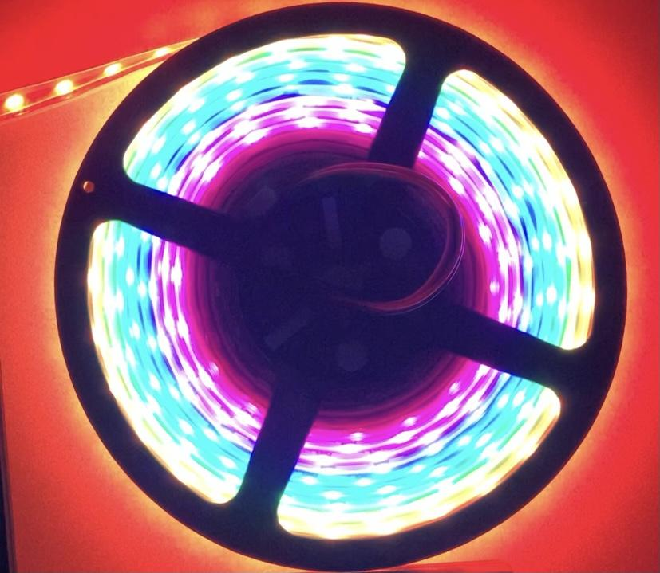
LED Visualizer Project
Samuel Pack, Wade Belanger, Jordi Kloosterboer, and Colby Hatton

Slide 2
Original Goal and Problems
Pitch and Volume
All LED colors would change based on the pitch of music.
Brightness and number LEDs would change based on volume of music.
There was the complexity of having multiple frequencies at different amounts of volume.
Fast Fourier Transform
Arduino can only sample at a rate of ~10 kHz, which means a max frequency of ~5 kHz due to the Nyquist–Shannon sampling theorem.
Notes:
Our original goal was to have an LED strip change depending on the pitch and volume of music.
All of the LEDs would change to the same color depending on the pitch of the music.
The brightness and the number of LEDs would change based on the volume of the music.
One problem with this was that music had multiple frequencies at different amounts of volume.
There was an option of using a library that incorporated Fast Fourier Transform and show frequencies from 1 Hz to about 5 kHz on the LED strip, but we thought it would be better and simpler to base the LEDs on the volume / the beats of the music.

Slide 3
Revised Goal
Number of LEDs is proportional to the volume of the music.
LED color is based on where the LED is.
Notes:
Therefore, our revised goal was to have the number of LEDs proportional to the volume of the music and have the LED color based on where the LED was.

Slide 4
Components
Arduino Uno
WS2812B LED Strip
30 KΩ Resistor
1 KΩ Resistor
LM385N Op-Amp
Audio Splitter
External Speaker

Slide 5
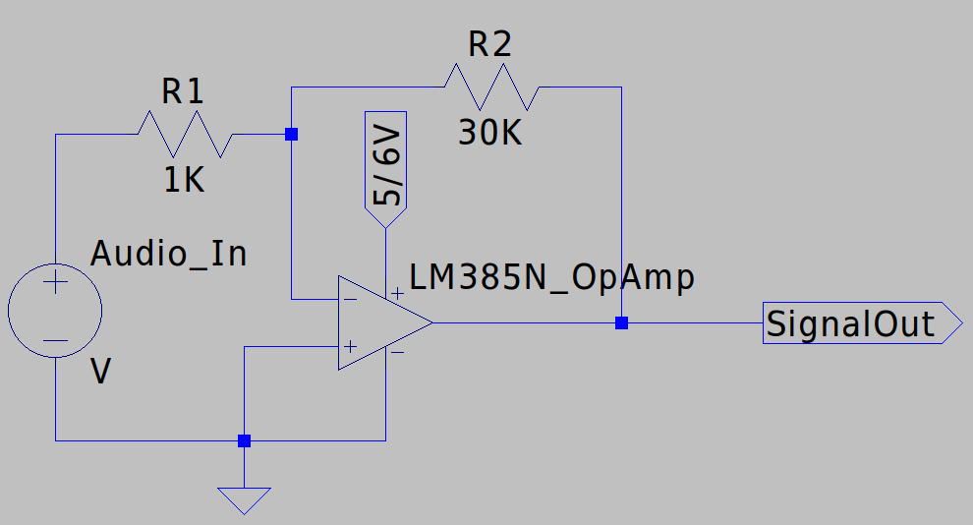
Schematic
Notes:
According to all known laws of aviation

Slide 6
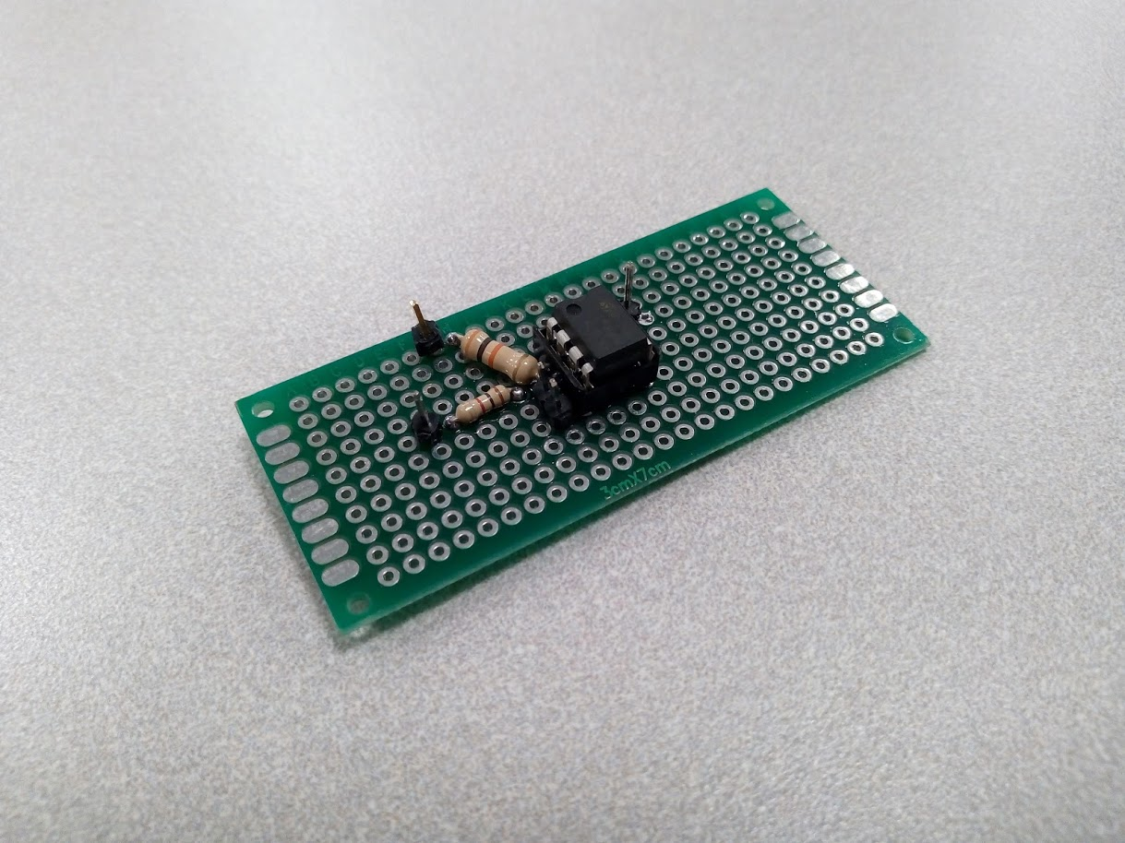

Slide 7
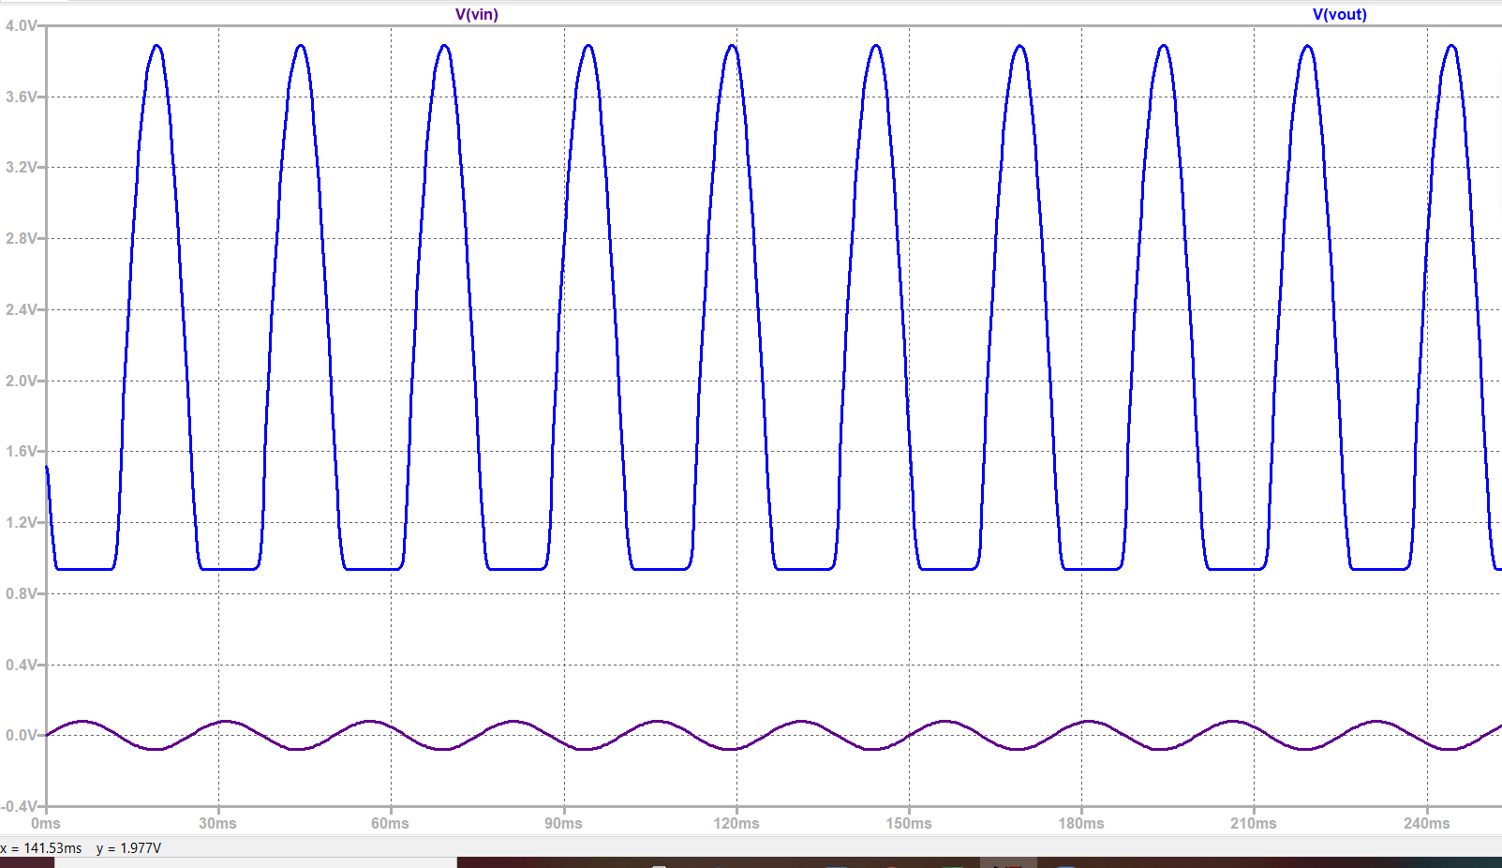
Waveform

Slide 8
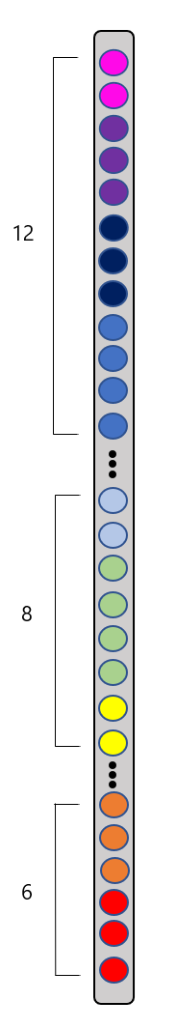
The Arduino Code
FastLED library
Progressive number of LEDs (6, 8, and 12) turning off and on.
Notes:
We saw on Amazon, where the LED strip was bought, that the FastLED library was a good fit for the LED strip we had. So we looked at its examples and the library’s documents to see how to incorporate it into our code.
Later in the project, we noticed a slight lag because we were showing each LED at a time.
Therefore, when lighting up the LEDs and turning them off, we progressively lit and unlit more LEDs at a time the farther out the LEDs were in the strip to reduce the lag. The number of LEDs lit and unlit at a time was 6, 8, and 12 as shown in the picture. 6 at the red end, 8 in the middle and 12 at the pink end.

Slide 9
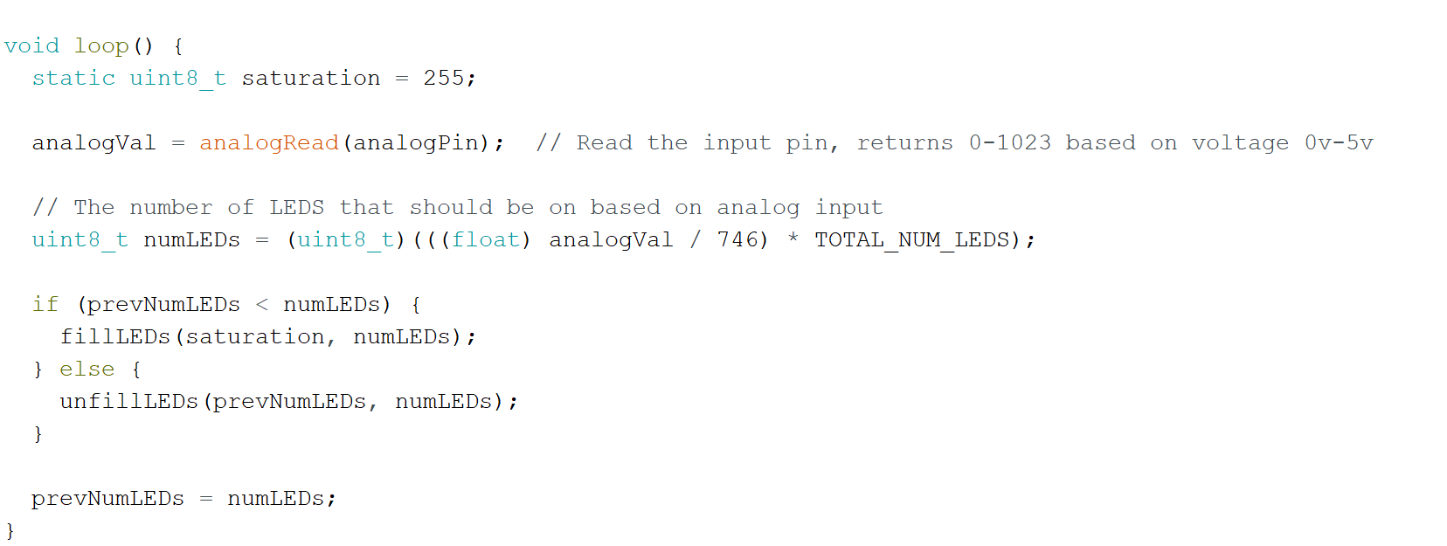

Slide 10


Slide 13
Potential Future Developments
-Color changes based on frequency
-User friendly packaging (Enclosure, pcb attaching to arduino uno)
-Device compatibility

Slide 14
Questions?

